Slide 1




Open Source
Security on AWS
Cristóbal Espinosa Morente
Cloud & Security Manager
Feel free to leave your comment on #OpenExpo19

Slide 2

Agenda
Many things to tell you in just only 30 minutes
1
Who am I?
4
Offensive projects
A short description of the speaker
Let’s play Rock & Roll!
2
5
AWS Open Source
Auditing projects
Amazon is part of the open source community
Security monitoring is a good practice
3
6
Defensive projects
Training projects
You should start defending your resources
Never stop learning
Feel free to leave your comment on #OpenExpo19
SecurityInside.info || @security_inside

Slide 3
WHO AM I?

Slide 4












Who am I?
A short description of the speaker
Cristóbal Espinosa Morente
Cloud & Security Manager – Accenture
Feel free to leave your comment on #OpenExpo19
SecurityInside.info || @security_inside

Slide 5
AWS OPEN SOURCE

Slide 6
AWS Open Source
Amazon is part of the open source community
https://aws.amazon.com/es/blogs/opensource
https://twitter.com/awsopen
Amazon is part of the open source community. They have been contributing to hundreds of projects for over a decade.
They are committed to working with, supporting, and contributing to new and existing open source projects that provide value to their customers and partners.
AWS has always aimed to take technology that was traditionally cost-prohibitive and difficult for many organizations to adopt, and make it accessible to a much broader audience.
Open source is just one more way that they seek to make technology more accessible to everyone.
Feel free to leave your comment on #OpenExpo19
SecurityInside.info || @security_inside

Slide 7
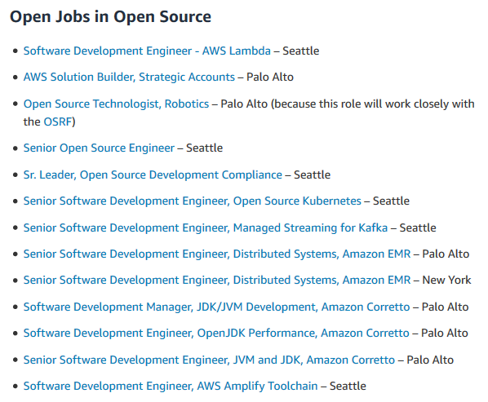
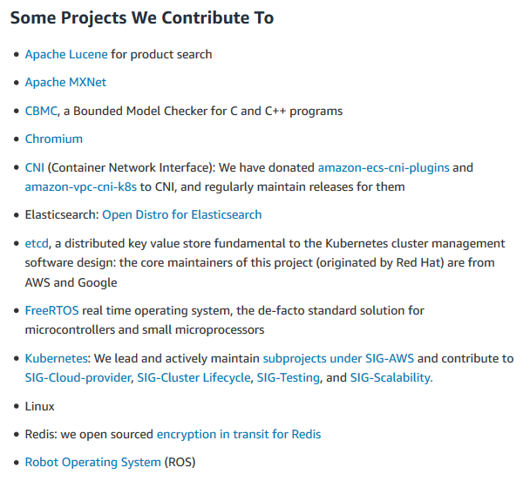
AWS Open Source
Amazon is part of the open source community
https://aws.amazon.com/es/opensource
Feel free to leave your comment on #OpenExpo19
SecurityInside.info || @security_inside

Slide 8
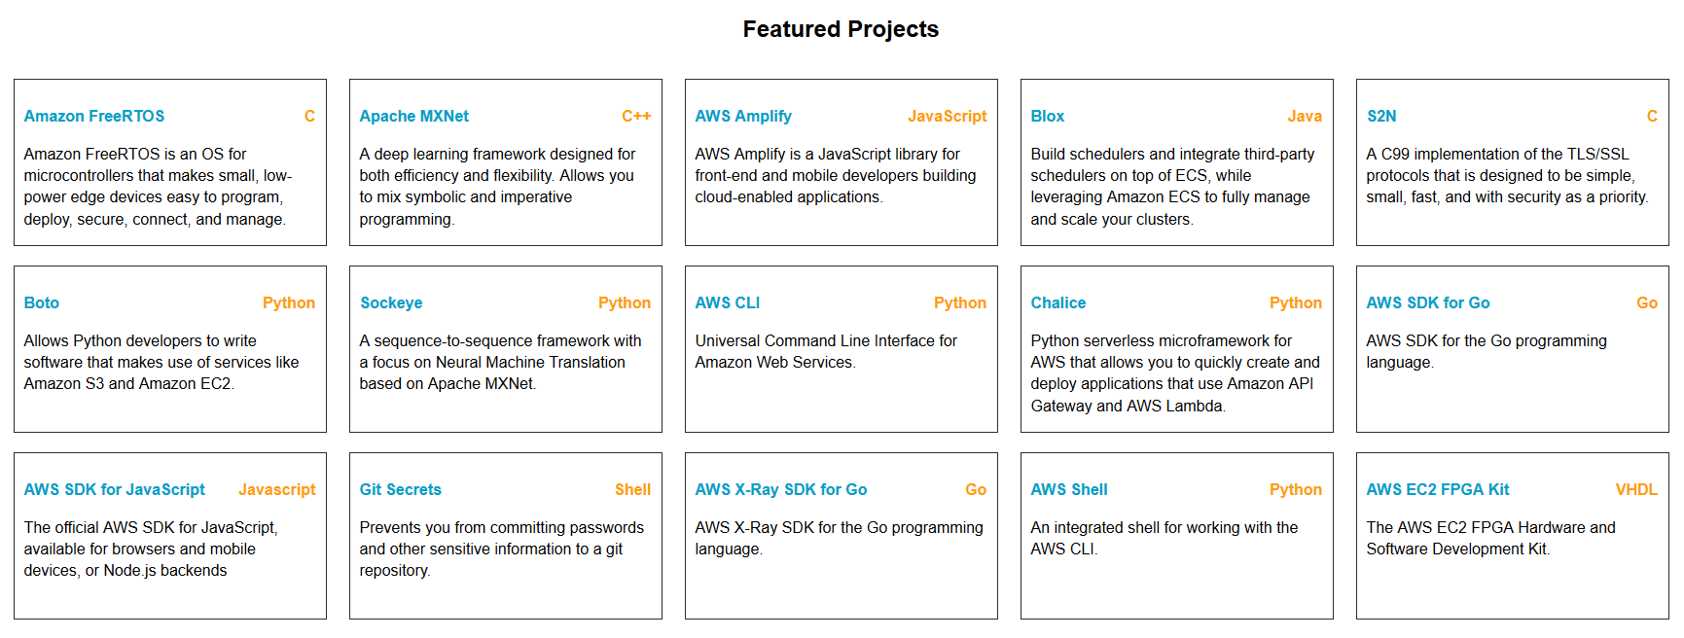
AWS Open Source
Amazon is part of the open source community
https://aws.github.io
Feel free to leave your comment on #OpenExpo19
SecurityInside.info || @security_inside

Slide 9
DEFENSIVE PROJECTS

Slide 10

Defensive Projects
You should start defending your resources
Prowler
https://github.com/toniblyx/prowler
Prowler is a command line tool for AWS Security Best Practices Assessment, Auditing and Hardening.
It follows guidelines of the CIS (Center for Internet Security) Amazon Web Services Foundations Benchmark (49 checks) and has 40 additional checks including related to GDPR and HIPAA.
Identity and Access Management (22 checks)
Logging (9 checks)
Monitoring (14 checks)
Networking (4 checks)
Forensics
CIS Level 1
CIS Level 2
Extras (39 checks)
GDPR
HIPAA
Feel free to leave your comment on #OpenExpo19
SecurityInside.info || @security_inside

Slide 11

Defensive Projects
You should start defending your resources
Prowler
https://github.com/toniblyx/prowler
Feel free to leave your comment on #OpenExpo19
SecurityInside.info || @security_inside

Slide 12
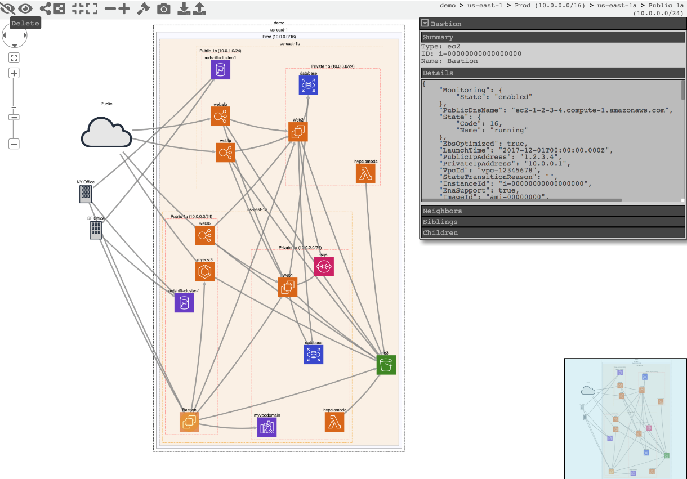
Defensive Projects
You should start defending your resources
CloudMapper
https://github.com/duo-labs/cloudmapper
CloudMapper helps you analyze your Amazon Web Services (AWS) environments. The original purpose was to generate network diagrams and display them in your browser.
It now contains much more functionality, including auditing for security issues
Feel free to leave your comment on #OpenExpo19
SecurityInside.info || @security_inside

Slide 13
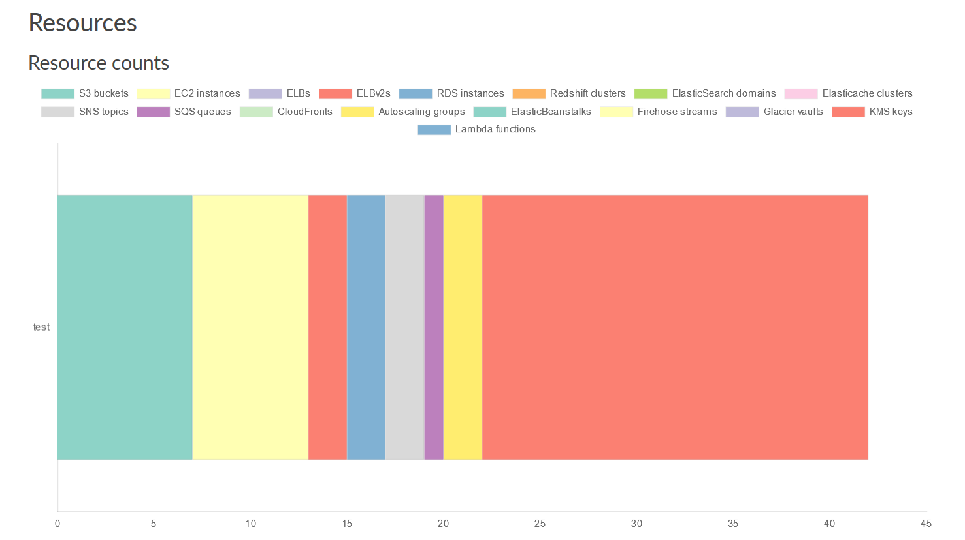
Defensive Projects
You should start defending your resources
CloudMapper
https://github.com/duo-labs/cloudmapper
Feel free to leave your comment on #OpenExpo19
SecurityInside.info || @security_inside

Slide 14
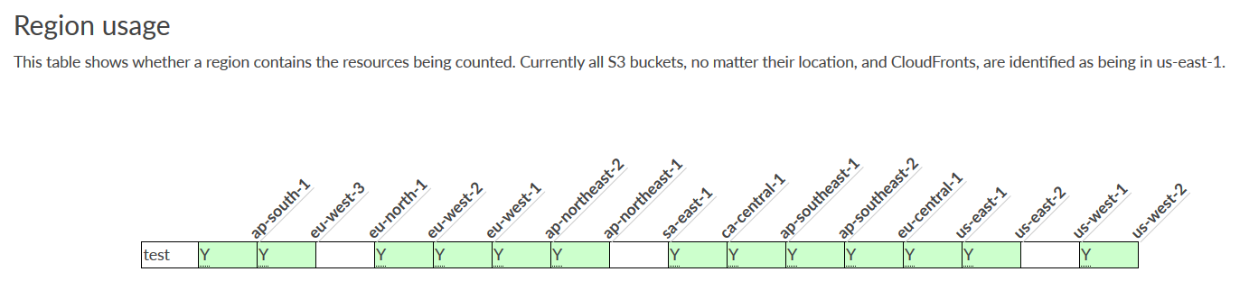
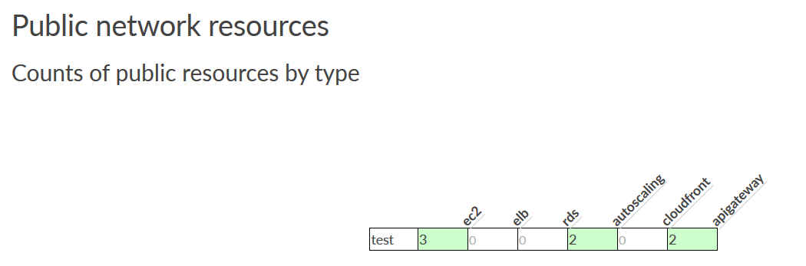
Defensive Projects
You should start defending your resources
CloudMapper
https://github.com/duo-labs/cloudmapper
Feel free to leave your comment on #OpenExpo19
SecurityInside.info || @security_inside

Slide 15
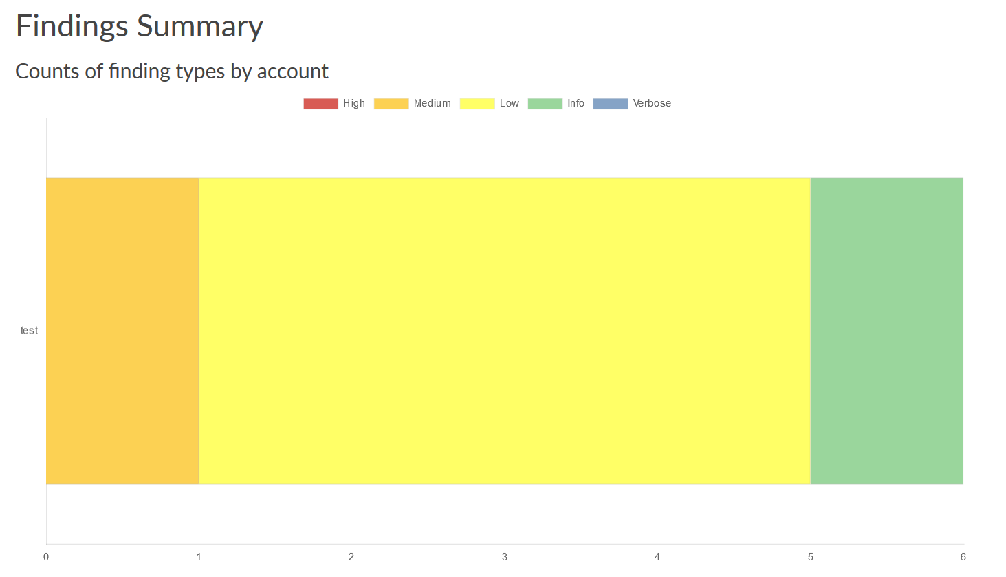
Defensive Projects
You should start defending your resources
CloudMapper
https://github.com/duo-labs/cloudmapper
Feel free to leave your comment on #OpenExpo19
SecurityInside.info || @security_inside

Slide 16
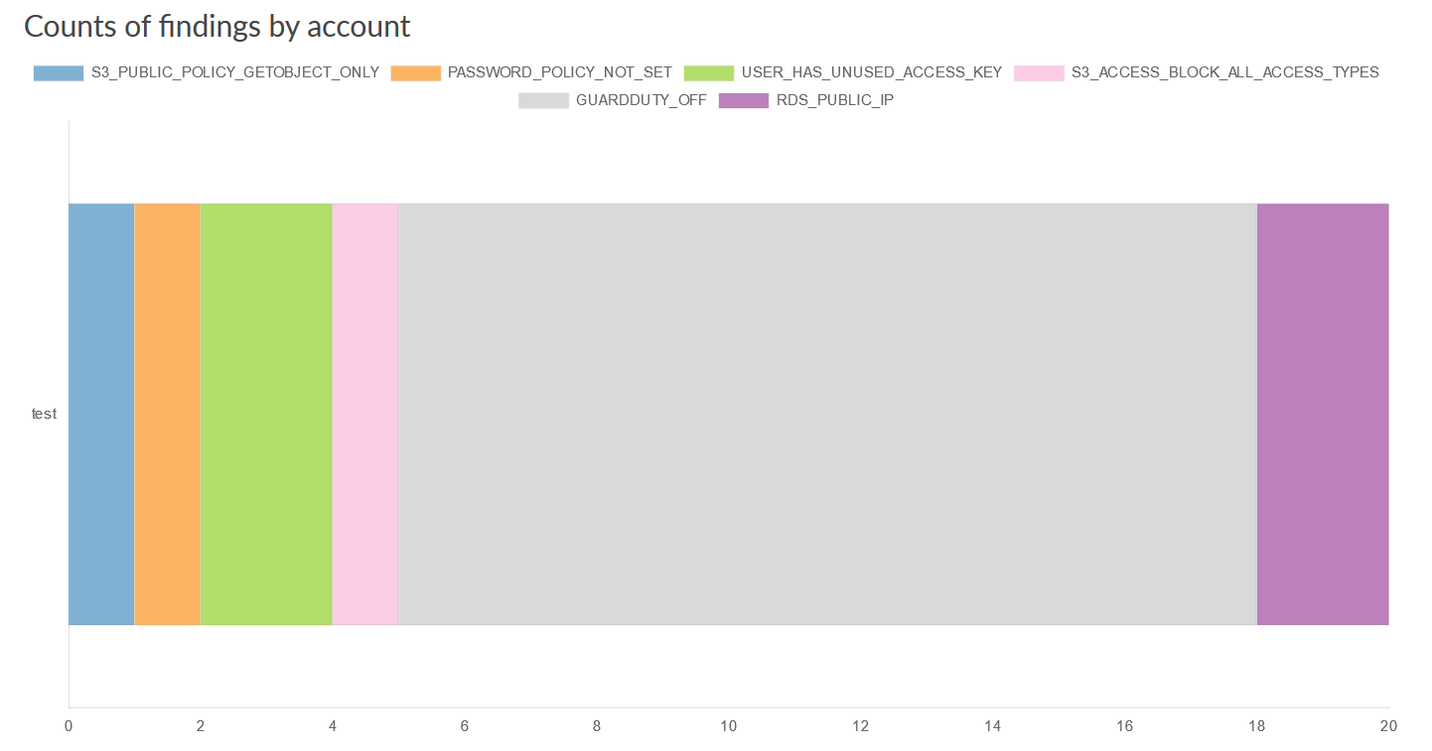
Defensive Projects
You should start defending your resources
CloudMapper
https://github.com/duo-labs/cloudmapper
Feel free to leave your comment on #OpenExpo19
SecurityInside.info || @security_inside

Slide 17
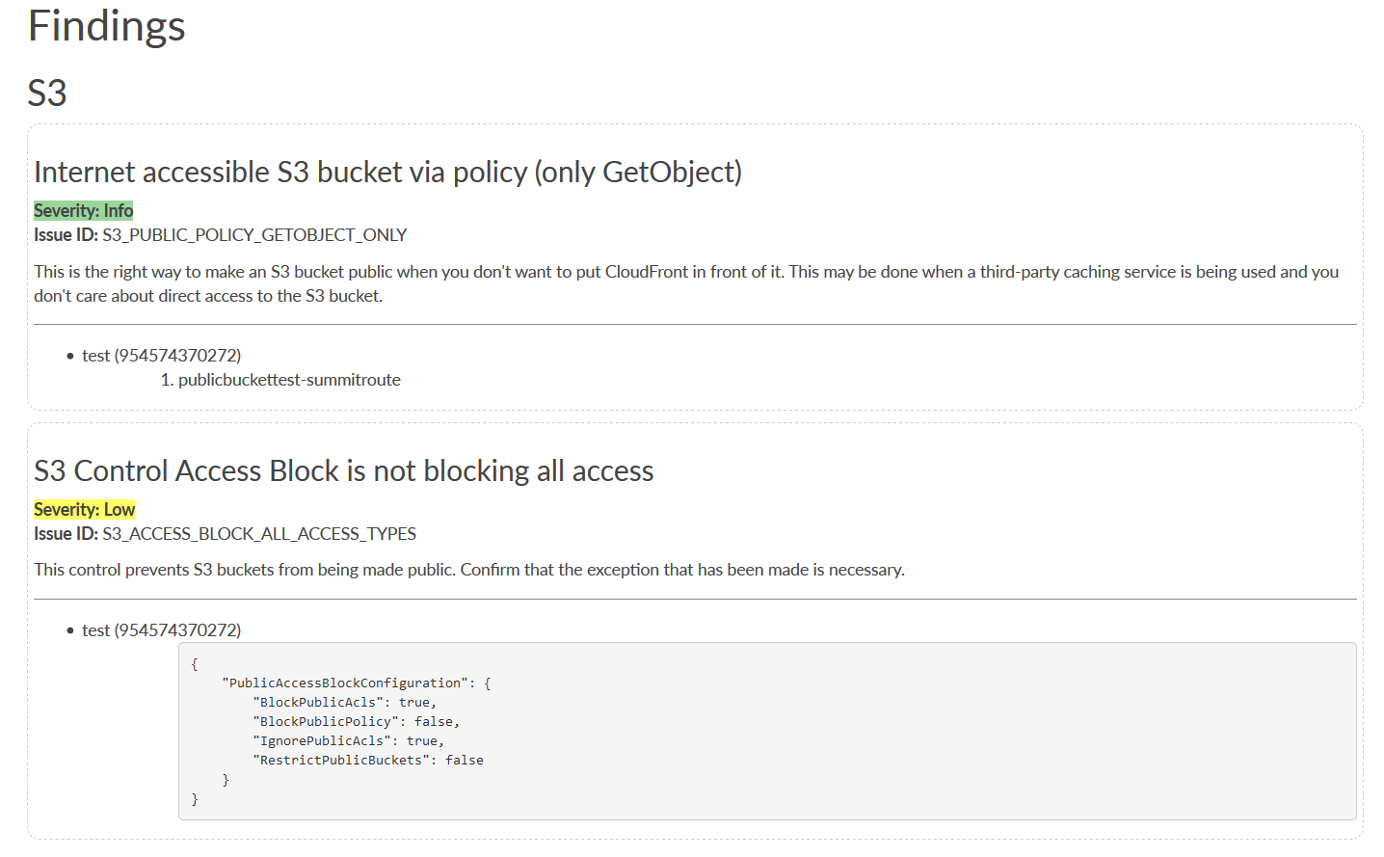
Defensive Projects
You should start defending your resources
CloudMapper
https://github.com/duo-labs/cloudmapper
Feel free to leave your comment on #OpenExpo19
SecurityInside.info || @security_inside

Slide 18
OFFENSIVE PROJECTS

Slide 19

Offensive Projects
Let’s play Rock & Roll!
Pacu
https://github.com/RhinoSecurityLabs/pacu
Pacu is an open source AWS exploitation framework, designed for offensive security testing against cloud environments.
Current modules enable a range of attacks, including user privilege escalation, backdooring of IAM users, attacking vulnerable Lambda functions, and much more.
confirm_permissions – Enumerates a list of confirmed permissions for the current account.
privesc_scan – Abuses 20+ different privilege escalation methods to gain further access.
sysman_ec2_rce – Abuses the AWS Simple Systems Manager to try and gain root (Linux) or SYSTEM (Windows) on EC2 instances.
Feel free to leave your comment on #OpenExpo19
SecurityInside.info || @security_inside

Slide 20

Offensive Projects
Let’s play Rock & Roll!
Pacu
https://github.com/RhinoSecurityLabs/pacu
Feel free to leave your comment on #OpenExpo19
SecurityInside.info || @security_inside

Slide 21

Offensive Projects
Let’s play Rock & Roll!
Pacu
https://github.com/RhinoSecurityLabs/pacu
Feel free to leave your comment on #OpenExpo19
SecurityInside.info || @security_inside

Slide 22
AUDITING PROJECTS

Slide 23
Auditing Projects
Security monitoring is a good practice
Security Monkey
https://github.com/Netflix/security_monkey
Security Monkey monitors your AWS accounts for policy changes and alerts on insecure configurations. It provides a single UI to browse and search through all of your accounts, regions, and cloud services.
The monkey remembers previous states and can show you exactly what changed, and when.
There are a number of security-relevant AWS components and configuration items — for example, security groups, S3 bucket policies, and IAM users.
Changes or misconfigurations in any of these items could create an unnecessary and dangerous security risk.
Feel free to leave your comment on #OpenExpo19
SecurityInside.info || @security_inside

Slide 24
Auditing Projects
Security monitoring is a good practice
Security Monkey
https://github.com/Netflix/security_monkey
Feel free to leave your comment on #OpenExpo19
SecurityInside.info || @security_inside

Slide 25
TRAINING PROJECTS

Slide 26
Training Projects
Never stop learning
CloudGoat
https://github.com/RhinoSecurityLabs/cloudgoat
CloudGoat is used to deploy a vulnerable set of AWS resources, designed to teach AWS security risks. They ensure that all vulnerabilities included are only exploitable by someone with access to the given AWS account.
This includes white listing access to sensitive resources to a personal IP address you supply where possible.
One of the primary drivers for developing CloudGoat was to support research and development of Pacu, the open-source AWS attack framework mentioned before.
Feel free to leave your comment on #OpenExpo19
SecurityInside.info || @security_inside

Slide 27
QUESTIONS?
Feel free to leave your comment on #OpenExpo19
SecurityInside.info || @security_inside

Slide 28
Open Source
Security on AWS
THANK YOU!
Feel free to leave your comment on #OpenExpo19

